Slide 1

Level Up Skilling Workshop

Slide 2






Why are we here?
Examine
Demos
Which one?
Raise Dapr awareness
What it is
What it does
How it works
Why should you embrace it
When you should embrace it
Understand
Question
Key Takeaways
1
Discuss key concepts
2
Demonstrate its value proposition
3
Help you Get Started

Slide 3
Welcome!
CSU Level up training class
Focus is on Dapr (Distributed Application Runtime)
Hands-on learning class
Going to optimize an existing .NET Core IoT application with Dapr
Outcomes:
Deep learning about Dapr for CSAs and CEs
Understand its value proposition and how it can help customers reduce complexity when constructing microservice apps
Drive customer application engagements that run in the Azure cloud
Notes:
H1 Roundtable Participant Survey Results:
94% (T2B) felt participating in a roundtable was a valuable use of their time.
88% (T2B) indicated that they were more likely to adopt/use the product or service because of their participation in the roundtable session.
94% (T2B) would participate in a future roundtable session if offered.
Link to .OFT:
Link to register:

Slide 4
Agenda
Workshop Introduction
Dapr Introduction, Ori Zohar
Brief microservice overview
Reference application review
Code Dapr!
Notes:
H1 Roundtable Participant Survey Results:
94% (T2B) felt participating in a roundtable was a valuable use of their time.
88% (T2B) indicated that they were more likely to adopt/use the product or service because of their participation in the roundtable session.
94% (T2B) would participate in a future roundtable session if offered.
Link to .OFT:
Link to register:

Slide 5
Coaching Staff
Dan Biscup, CSA, Fed
Randy Patterson, CE, National
Kidambi Narasimhan, CSA, Fed
Tim Oleson, CE, Manufacturing
Eldon Gormsen, CSA, Fed
Rob Vettor, CSA, Fed
Aaron Bar, Chief Architect, Fed
Greg Roe, CSA, Fed
Rick Rainey, CSA, Fed
Larry Wall, CE, Manufacturing
Rick McGuire, CSA, National
Herb Raffaele, CSA, Fed
If you have question/issue, please type it into the chat
A coach will either…
Answer directly in the chat
Have you share you screen in a 1-1 session
Notes:
H1 Roundtable Participant Survey Results:
94% (T2B) felt participating in a roundtable was a valuable use of their time.
88% (T2B) indicated that they were more likely to adopt/use the product or service because of their participation in the roundtable session.
94% (T2B) would participate in a future roundtable session if offered.
Link to .OFT:
Link to register:

Slide 6
Workshop Environment
Git
.NET 5 SDK
Visual Studio Code
C# extensions
Rest Client extensions
Docker Desktop (Linux mode)
Dapr
Typora (optional markdown reader)
Notes:
H1 Roundtable Participant Survey Results:
94% (T2B) felt participating in a roundtable was a valuable use of their time.
88% (T2B) indicated that they were more likely to adopt/use the product or service because of their participation in the roundtable session.
94% (T2B) would participate in a future roundtable session if offered.
Link to .OFT:
Link to register:

Slide 7

Dapr Introduction Ori Zohar Senior, Azure Incubations

Slide 8
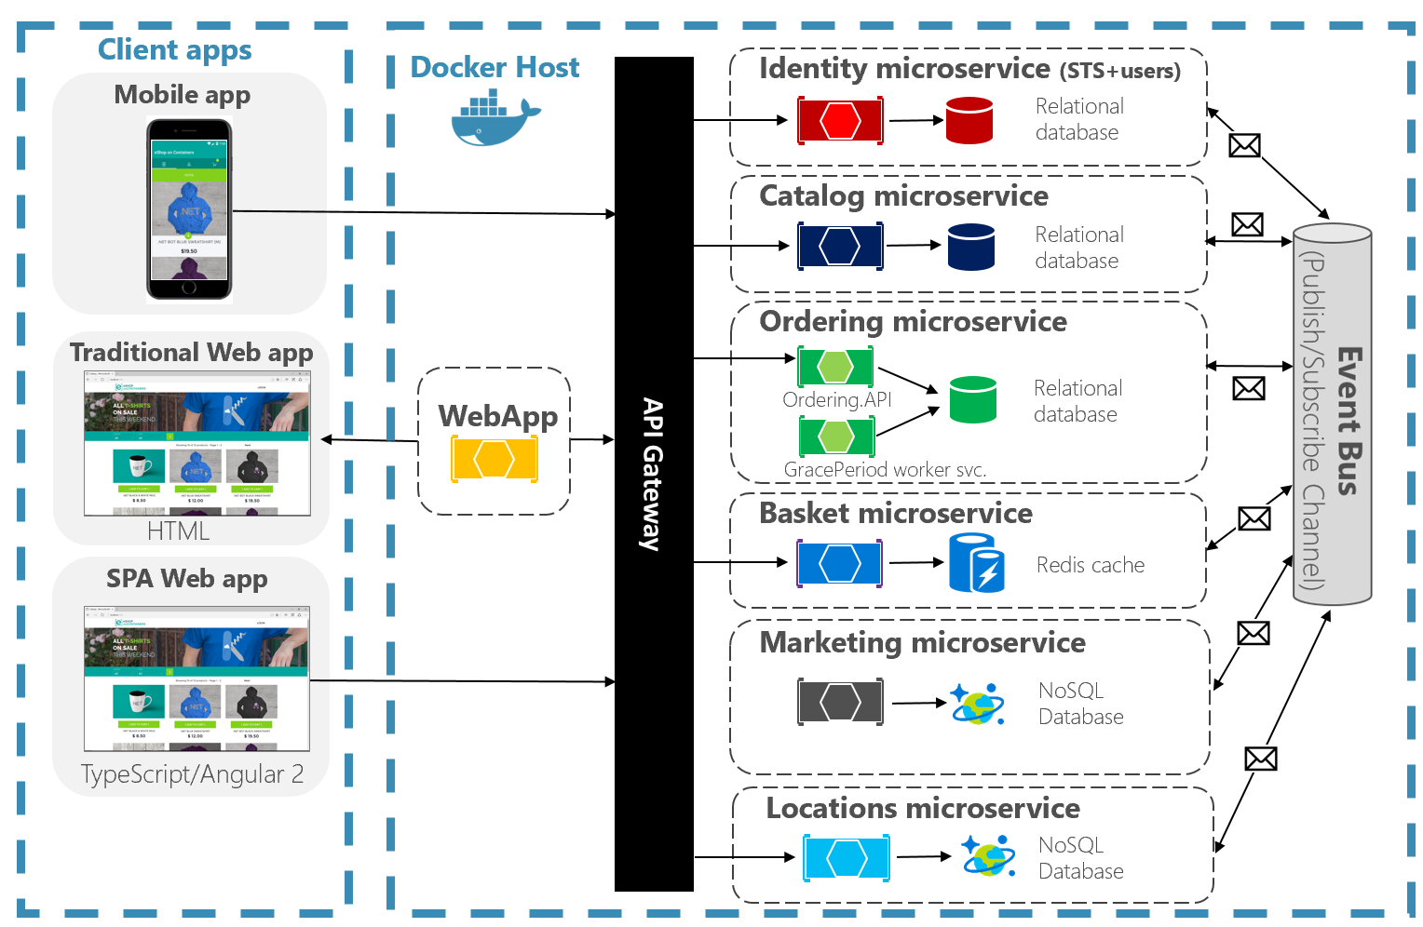
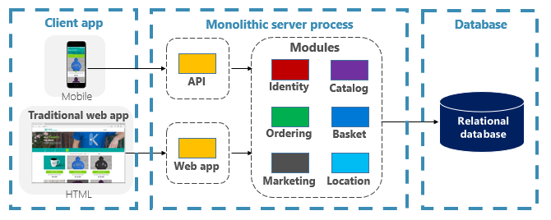
Microservices evolution
Customers are evolving from monolithic to distributed microservice based apps…
Microservices provide agility:
Services closely align to organizational capabilities
Each can evolve independently and deploy frequently
Can rapidly respond to changing market conditions
Instantaneously update small areas of a live applications
Monolithic Architecture
Microservices Architecture
Notes:
H1 Roundtable Participant Survey Results:
94% (T2B) felt participating in a roundtable was a valuable use of their time.
88% (T2B) indicated that they were more likely to adopt/use the product or service because of their participation in the roundtable session.
94% (T2B) would participate in a future roundtable session if offered.
Link to .OFT:
Link to register:

Slide 9
Microservice challenges
Hosting independent, self-contained microservices require significant amounts of custom infrastructure code: Complex to build and expensive to maintain
1
5
2
Plumbing Concerns:
Service invocation
Pub/Sub messaging
Managing state
Binding to other services
Managing secrets
1
2
5
1
1
2
2
1
4
3
5
3
2
4
1
2
5
5
3
2
5
1
3
4
Notes:
H1 Roundtable Participant Survey Results:
94% (T2B) felt participating in a roundtable was a valuable use of their time.
88% (T2B) indicated that they were more likely to adopt/use the product or service because of their participation in the roundtable session.
94% (T2B) would participate in a future roundtable session if offered.
Link to .OFT:
Link to register:

Slide 10


Introducing Dapr
Consistent, portable, open APIs
Supports any language or framework
Distributed Application Runtime
Extensible and pluggable components
Platform agnostic: Runs on cloud + edge
Portable, event-driven, runtime for building distributed applications across cloud and edge
Built-in best-practices
Community driven vendor neutral
https://dapr.io
Notes:
H1 Roundtable Participant Survey Results:
94% (T2B) felt participating in a roundtable was a valuable use of their time.
88% (T2B) indicated that they were more likely to adopt/use the product or service because of their participation in the roundtable session.
94% (T2B) would participate in a future roundtable session if offered.
Link to .OFT:
Link to register:

Slide 11

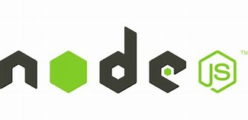


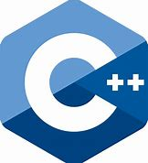











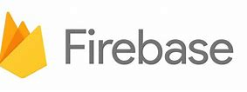










High-level architecture
Application code
App and platform runtime
Microservices written in
Any code or framework…
HTTP API
gRPC API
Service-to- service invocation
State management
Publish and subscribe
Bindings
(input/output)
Actors
Observability
Secrets
Extensible
runtime
Building blocks
Components
EventHub
Kafka
AWS SQS
GCP pub/sub
AWS
DynamoDB
CosmosDB
Service Bus
Prometheus
AppInsightts
Jaeger
Any cloud or edge infrastructure
Hosting
Notes:
H1 Roundtable Participant Survey Results:
94% (T2B) felt participating in a roundtable was a valuable use of their time.
88% (T2B) indicated that they were more likely to adopt/use the product or service because of their participation in the roundtable session.
94% (T2B) would participate in a future roundtable session if offered.
Link to .OFT:
Link to register:

Slide 12
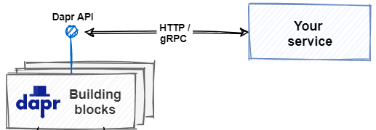
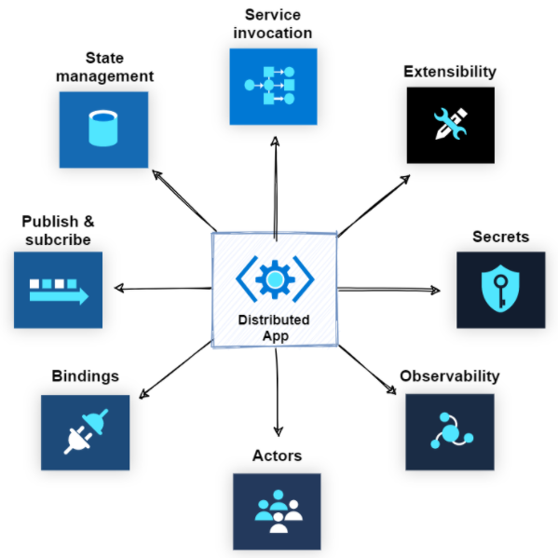
Building blocks
Your service consumes Dapr building blocks
They provide a common interface to communicate with underlying infrastructure components
Your app consumes building blocks through HTTP or gRPC APIs – not directly
Your service is loosely-coupled to the building blocks and their underlying functionality
Your service has no dependencies on external SDKs or libraries
Notes:
H1 Roundtable Participant Survey Results:
94% (T2B) felt participating in a roundtable was a valuable use of their time.
88% (T2B) indicated that they were more likely to adopt/use the product or service because of their participation in the roundtable session.
94% (T2B) would participate in a future roundtable session if offered.
Link to .OFT:
Link to register:

Slide 13
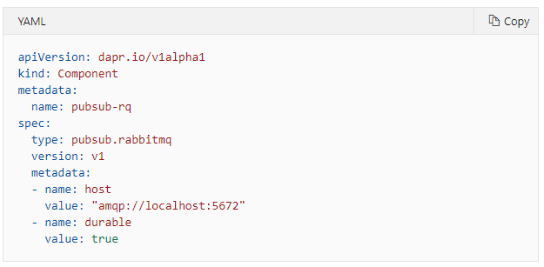
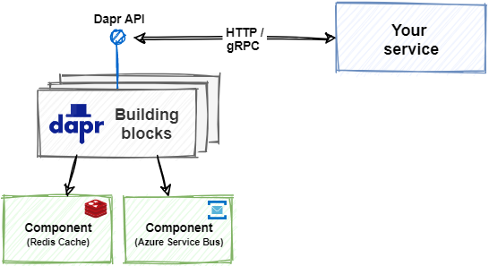
Components
Building blocks consume Dapr components
A component provides the concrete implementation for an infrastructure resource
Developers specify the infrastructure resource inside a simple YAML configuration file
Components are pluggable - You can switch among them without any code change – simply update the configuration file
Pluggable components include:
Azure Service Bus
Rabbit MQ
Apache Kafka
Azure Event Hubs
Redis Streams
Notes:
H1 Roundtable Participant Survey Results:
94% (T2B) felt participating in a roundtable was a valuable use of their time.
88% (T2B) indicated that they were more likely to adopt/use the product or service because of their participation in the roundtable session.
94% (T2B) would participate in a future roundtable session if offered.
Link to .OFT:
Link to register:

Slide 14
71 Dapr Components
27 I/O Bindings
18 State stores
11 Pub/Sub
13 General
7 Azure
5 AWS
Aerospike
Cassandra
Cloudstate
Couchbase
etcd
Hashicorp Consul
Hazelcast
Memcached
MongoDB
PostgreSQL
RethinkDB
Redis
Zookeeper
Azure CosmosDB
Azure SQL Server
Azure Table Storage
Azure Blob Storage
Google Cloud Firestore
Redis Streams
Apache Kafka
AWS SNS/SQS
Azure Events Hub
Azure Service Bus
GCP Pub/Sub
Hazelcast
MQTT
NATS streaming
Pulsar
RabbitMQ
APNs
Cron (Scheduler)
HTTP
InfluxDB
Kafka
Kubernetes Events
MQTT
PostgreSql
RabbitMQ
Redis
Twilio
Twitter
SendGrid
Azure Blob Storage
Azure EventHubs
Azure CosmosDB
Azure Service Bus Queues
Azure SignalR
Azure Storage Queues
Azure Event Grid
AWS DynamoDB
AWS S3
AWS SNS
AWS SQS
AWS Kinesis
1 AliCloud
Blob Storage
2 GCP
GCP Cloud Pub/Sub
GCP Storage Bucket
8 Secret stores
Azure Key Vault secret store
Azure Key Vault with Kubernetes MI
AWS Secrets Manager
GCP Secret Manager
HashiCorp Vault
Kubernetes Secrets
Local environment variables (for Development)
Local file (for Development)
4 HTTP Middleware
2 Name Resolution
OAuth2
Open Policy Agent (OPA)
Rate limit
Bearer
Kubernetes
Multicast DNS

Slide 15
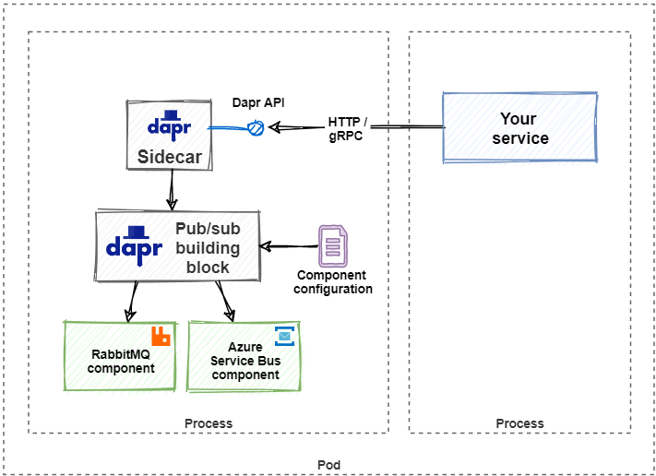
Sidecar
Dapr embraces a sidecar architecture
Building blocks and components are exposed through Sidecars
They encapsulate and isolate Dapr functionality from your service
Sidecars enable Dapr to run in a separate memory space or separate containers alongside your services
This separation enables Dapr to have a separate runtime environment from your services
Process
Process
Pod
Notes:
H1 Roundtable Participant Survey Results:
94% (T2B) felt participating in a roundtable was a valuable use of their time.
88% (T2B) indicated that they were more likely to adopt/use the product or service because of their participation in the roundtable session.
94% (T2B) would participate in a future roundtable session if offered.
Link to .OFT:
Link to register:

Slide 16
Introduce Reference App

Slide 17
Tips and Tricks
Suggest the step-by-step approach
Open VS Code at the ‘src’ folder level
Uses either GitHub or Typora to read lab instructions
Build after each change
When starting services, scan the output for errors
Use the app architecture as a lighthouse
Notes:
H1 Roundtable Participant Survey Results:
94% (T2B) felt participating in a roundtable was a valuable use of their time.
88% (T2B) indicated that they were more likely to adopt/use the product or service because of their participation in the roundtable session.
94% (T2B) would participate in a future roundtable session if offered.
Link to .OFT:
Link to register:

Slide 18
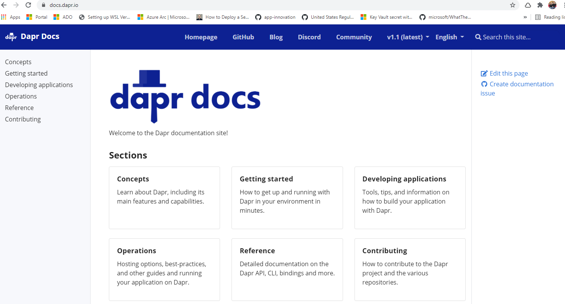
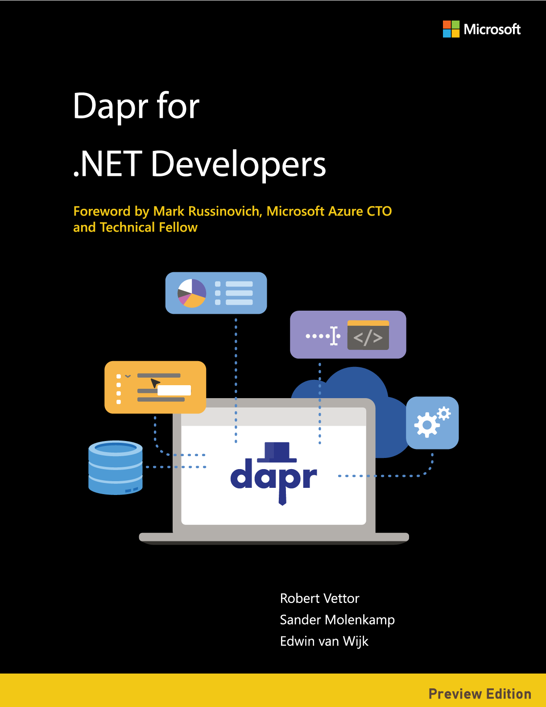
For reference…
Dapr.io
Darp for .NET Developers eBook
Notes:
H1 Roundtable Participant Survey Results:
94% (T2B) felt participating in a roundtable was a valuable use of their time.
88% (T2B) indicated that they were more likely to adopt/use the product or service because of their participation in the roundtable session.
94% (T2B) would participate in a future roundtable session if offered.
Link to .OFT:
Link to register:

Slide 19
https://github.com/robvet/dapr-workshop

Slide 20
Extra Slides

Slide 21
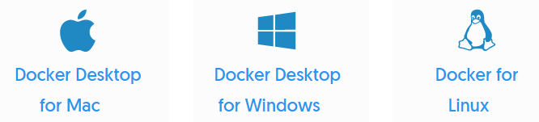


Installing Dapr
Install the Dapr CLI
Install Docker Desktop
Initialize Dapr
Install the App Platform SDK of choice
Notes:
H1 Roundtable Participant Survey Results:
94% (T2B) felt participating in a roundtable was a valuable use of their time.
88% (T2B) indicated that they were more likely to adopt/use the product or service because of their participation in the roundtable session.
94% (T2B) would participate in a future roundtable session if offered.
Link to .OFT:
Link to register:

Slide 22
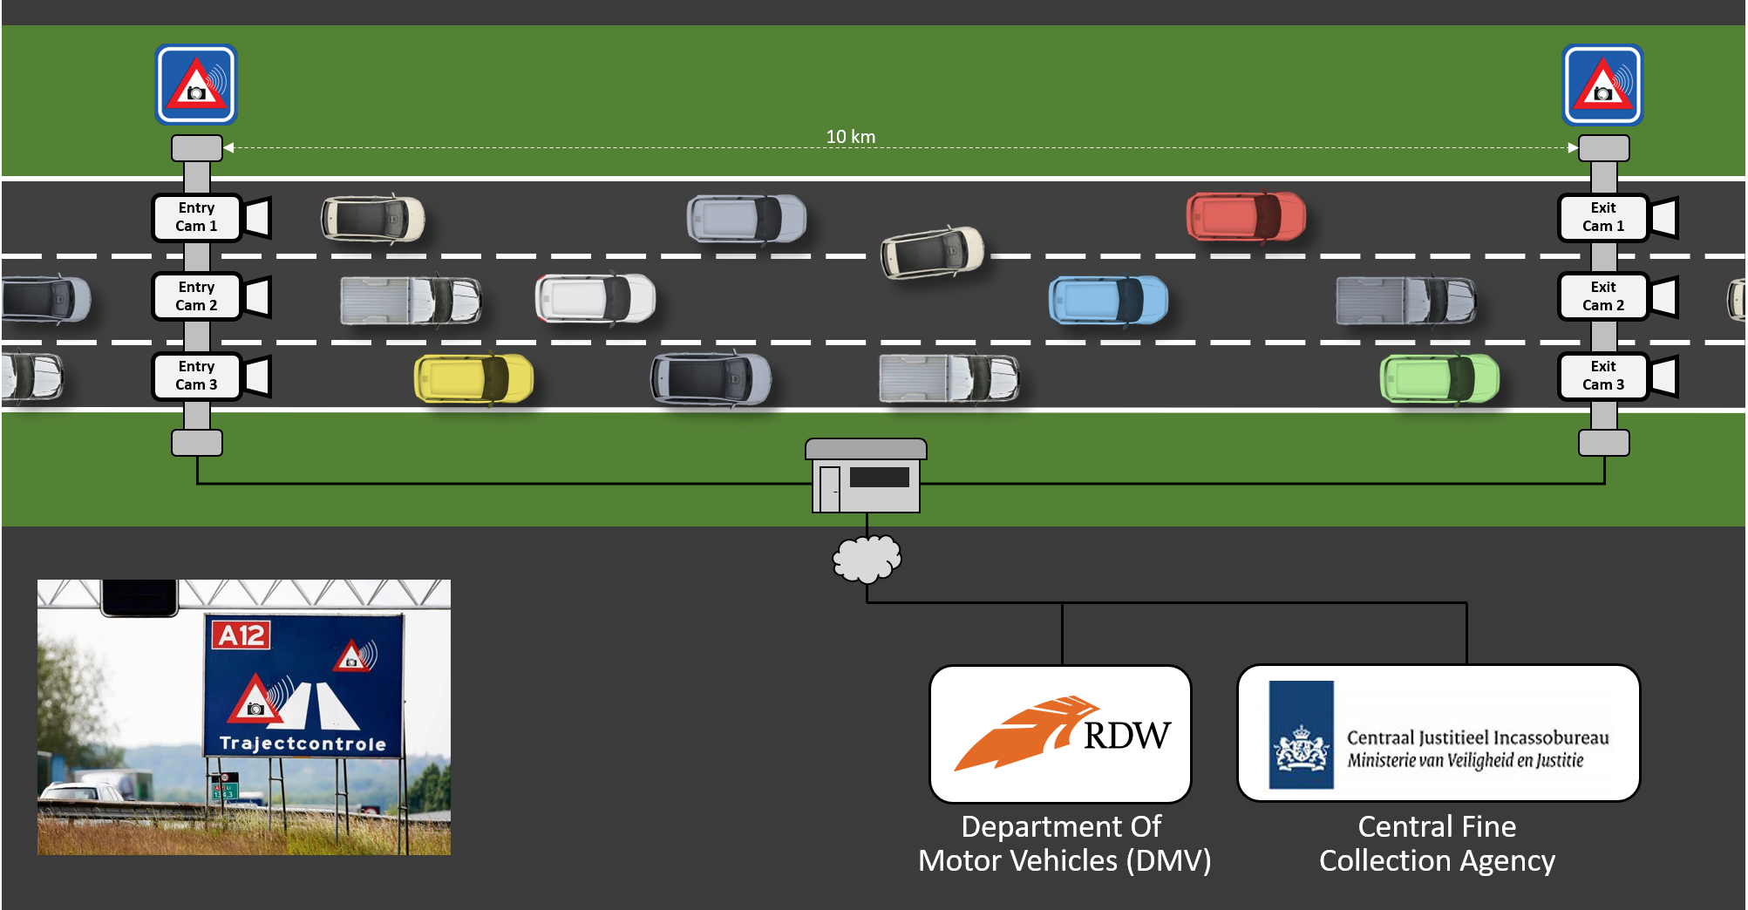
Demo App: Scenario
Tracking a driver’s speed with cameras…
Speed enforcement
Entry camera
Exit camera
Measures speed
Get driver info
Issue ticket my mail
1
2
1
2
3
4
5
3
4
5
Notes:
H1 Roundtable Participant Survey Results:
94% (T2B) felt participating in a roundtable was a valuable use of their time.
88% (T2B) indicated that they were more likely to adopt/use the product or service because of their participation in the roundtable session.
94% (T2B) would participate in a future roundtable session if offered.
Link to .OFT:
Link to register:

Slide 23
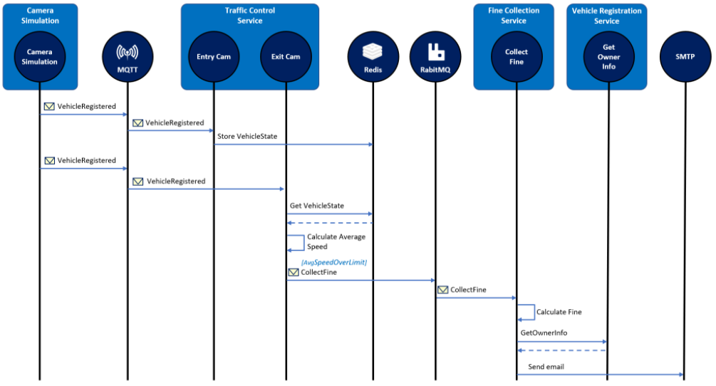
Demo App: Architecture
Notes:
H1 Roundtable Participant Survey Results:
94% (T2B) felt participating in a roundtable was a valuable use of their time.
88% (T2B) indicated that they were more likely to adopt/use the product or service because of their participation in the roundtable session.
94% (T2B) would participate in a future roundtable session if offered.
Link to .OFT:
Link to register:

Slide 24
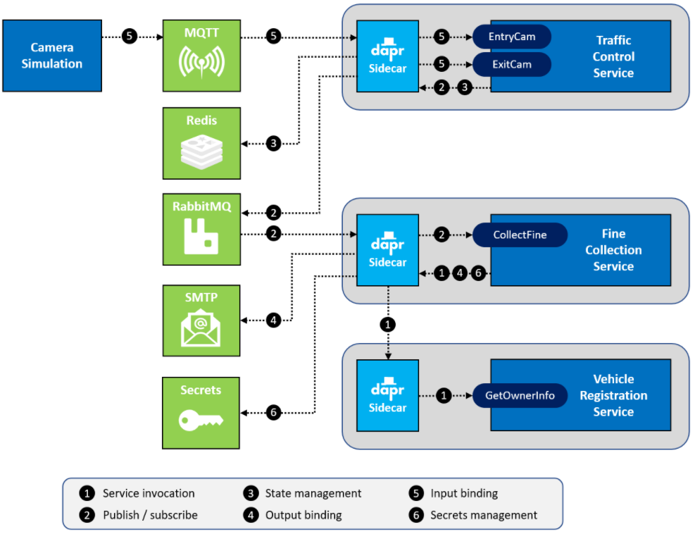
Demo App: Architecture
Notes:
H1 Roundtable Participant Survey Results:
94% (T2B) felt participating in a roundtable was a valuable use of their time.
88% (T2B) indicated that they were more likely to adopt/use the product or service because of their participation in the roundtable session.
94% (T2B) would participate in a future roundtable session if offered.
Link to .OFT:
Link to register:

Slide 25
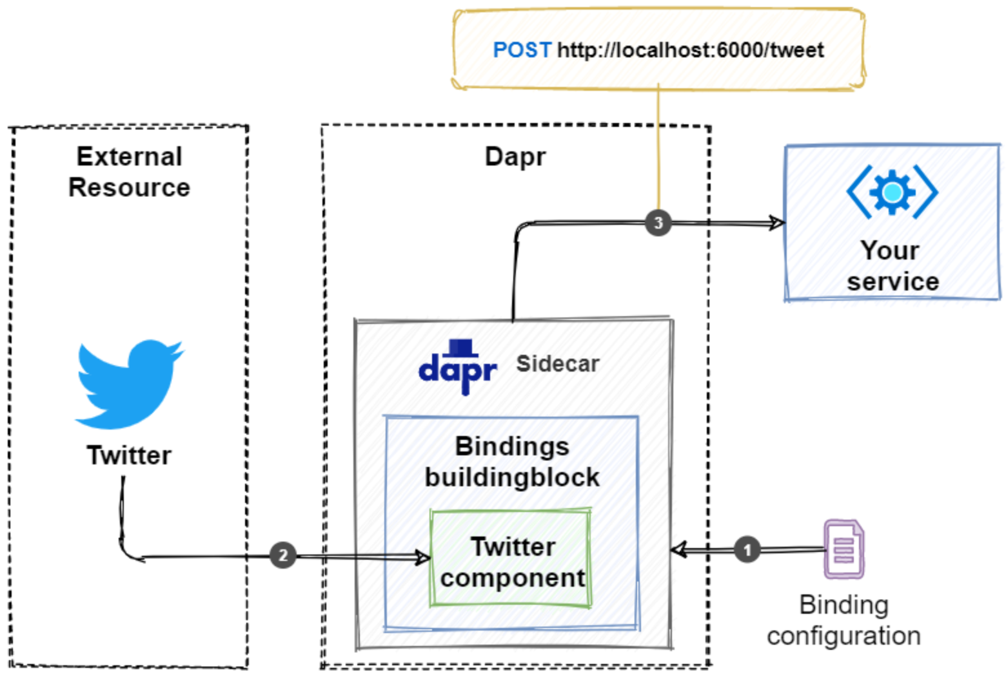
Bindings
Bindings building block
Bind incoming and outgoing events for an external resource
Similar to Azure Functions
Configuration file specifies…
External resource
Service endpoint to invoke (event handler)
Supported Bindings:
Azure CosmosDB
Azure Event Grid
Azure Event Hub
MySql
Postgres
Kafka
more…
Notes:
H1 Roundtable Participant Survey Results:
94% (T2B) felt participating in a roundtable was a valuable use of their time.
88% (T2B) indicated that they were more likely to adopt/use the product or service because of their participation in the roundtable session.
94% (T2B) would participate in a future roundtable session if offered.
Link to .OFT:
Link to register:

Slide 26
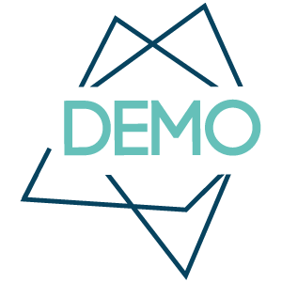
Dapr Bindings

Slide 27
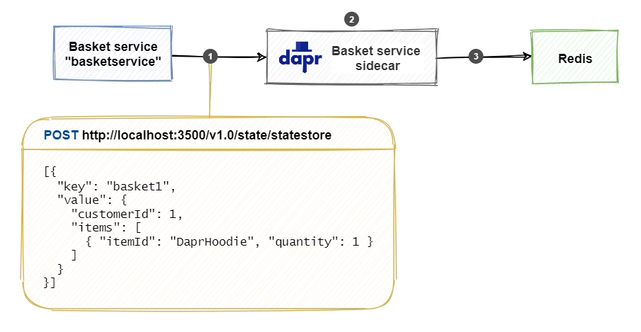
State Management
State Management building block
Encapsulates a distributed state store to maintain service state
Supports differing consistency levels
Built-in concurrency supports both “first-write wins” and “last-write wins” strategies
Limited support for transactions
State store components:
Azure CosmosDB
Azure SQL Server
MongoDB
PostgreSQL
Redis
Azure Blob Storage
Azure Table Storage
Cassandra
etcd
Google Cloud Firestore
Hashicorp Consul
more..
Notes:
H1 Roundtable Participant Survey Results:
94% (T2B) felt participating in a roundtable was a valuable use of their time.
88% (T2B) indicated that they were more likely to adopt/use the product or service because of their participation in the roundtable session.
94% (T2B) would participate in a future roundtable session if offered.
Link to .OFT:
Link to register:

Slide 28
Publish/Subscribe
Dapr building blocks encapsulate distributed infrastructure capabilities.
Notes:
H1 Roundtable Participant Survey Results:
94% (T2B) felt participating in a roundtable was a valuable use of their time.
88% (T2B) indicated that they were more likely to adopt/use the product or service because of their participation in the roundtable session.
94% (T2B) would participate in a future roundtable session if offered.
Link to .OFT:
Link to register:

Slide 29
Service Invocation
Dapr building blocks encapsulate distributed infrastructure capabilities.
Notes:
H1 Roundtable Participant Survey Results:
94% (T2B) felt participating in a roundtable was a valuable use of their time.
88% (T2B) indicated that they were more likely to adopt/use the product or service because of their participation in the roundtable session.
94% (T2B) would participate in a future roundtable session if offered.
Link to .OFT:
Link to register:

Slide 30
Secrets
Dapr building blocks encapsulate distributed infrastructure capabilities.
Notes:
H1 Roundtable Participant Survey Results:
94% (T2B) felt participating in a roundtable was a valuable use of their time.
88% (T2B) indicated that they were more likely to adopt/use the product or service because of their participation in the roundtable session.
94% (T2B) would participate in a future roundtable session if offered.
Link to .OFT:
Link to register:

Slide 31
Observability
Dapr building blocks encapsulate distributed infrastructure capabilities.
Notes:
H1 Roundtable Participant Survey Results:
94% (T2B) felt participating in a roundtable was a valuable use of their time.
88% (T2B) indicated that they were more likely to adopt/use the product or service because of their participation in the roundtable session.
94% (T2B) would participate in a future roundtable session if offered.
Link to .OFT:
Link to register:

Slide 32
Actors
Dapr building blocks encapsulate distributed infrastructure capabilities.
Notes:
H1 Roundtable Participant Survey Results:
94% (T2B) felt participating in a roundtable was a valuable use of their time.
88% (T2B) indicated that they were more likely to adopt/use the product or service because of their participation in the roundtable session.
94% (T2B) would participate in a future roundtable session if offered.
Link to .OFT:
Link to register:

Slide 33
Functions
Dapr building blocks encapsulate distributed infrastructure capabilities.
Notes:
H1 Roundtable Participant Survey Results:
94% (T2B) felt participating in a roundtable was a valuable use of their time.
88% (T2B) indicated that they were more likely to adopt/use the product or service because of their participation in the roundtable session.
94% (T2B) would participate in a future roundtable session if offered.
Link to .OFT:
Link to register:

Slide 34
Logic Apps
Dapr building blocks encapsulate distributed infrastructure capabilities.
Notes:
H1 Roundtable Participant Survey Results:
94% (T2B) felt participating in a roundtable was a valuable use of their time.
88% (T2B) indicated that they were more likely to adopt/use the product or service because of their participation in the roundtable session.
94% (T2B) would participate in a future roundtable session if offered.
Link to .OFT:
Link to register:

Slide 35
APIM
Dapr building blocks encapsulate distributed infrastructure capabilities.
Notes:
H1 Roundtable Participant Survey Results:
94% (T2B) felt participating in a roundtable was a valuable use of their time.
88% (T2B) indicated that they were more likely to adopt/use the product or service because of their participation in the roundtable session.
94% (T2B) would participate in a future roundtable session if offered.
Link to .OFT:
Link to register:

Slide 36
The Road Ahead
Dapr building blocks encapsulate distributed infrastructure capabilities.
Notes:
H1 Roundtable Participant Survey Results:
94% (T2B) felt participating in a roundtable was a valuable use of their time.
88% (T2B) indicated that they were more likely to adopt/use the product or service because of their participation in the roundtable session.
94% (T2B) would participate in a future roundtable session if offered.
Link to .OFT:
Link to register:

Slide 38
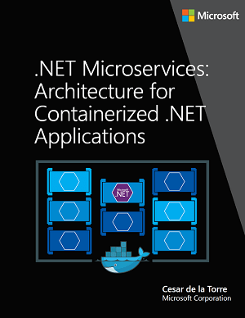
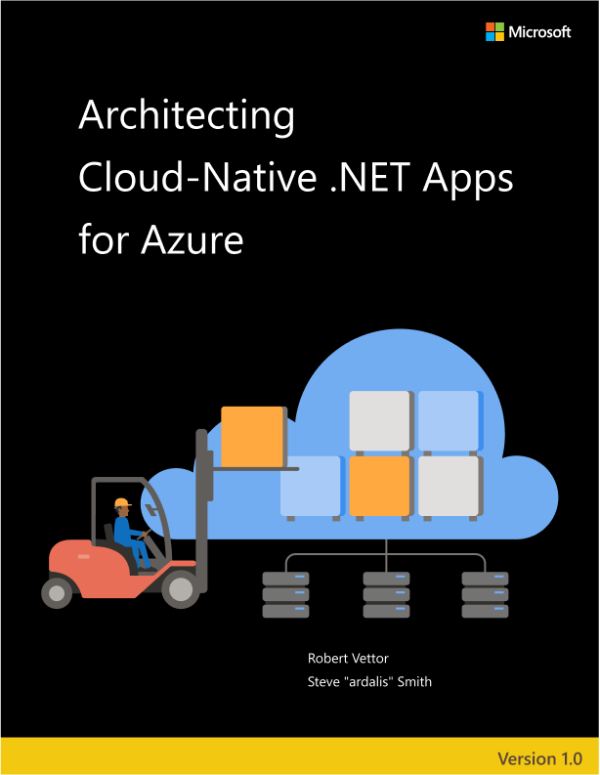
Microservice – learn more
For more on Microservices, check out two free guidance eBooks from Microsoft…
Depth in microservice architecture
Blend cloud native and microservices
Notes:
H1 Roundtable Participant Survey Results:
94% (T2B) felt participating in a roundtable was a valuable use of their time.
88% (T2B) indicated that they were more likely to adopt/use the product or service because of their participation in the roundtable session.
94% (T2B) would participate in a future roundtable session if offered.
Link to .OFT:
Link to register:

Slide 39


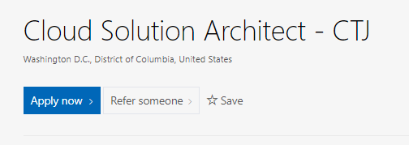

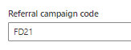




Enhanced Federal Referral Program
How IT Works
Active TS/SCI w/ Poly (CI or FSP)
$10,000
Go directly to applicable job posting on careers
Active TS w/ SCI
$5,000
Click “Refer someone” Enter “FD21” in “Referral campaign code” field
Active TS
$2,000
Complete and submit referral form
All Others
$1,000
The clearance required for the role determines the referral amount

Slide 40
Business Updates

Slide 41

Microsoft Federal
Thank You
Notes:
Big thanks to all of our presenters and all the amazing work happening across this team…hope you’ve enjoyed us taking time to celebrate you and the work we’re doing to better celebrate you
Ask you

